Slide 1
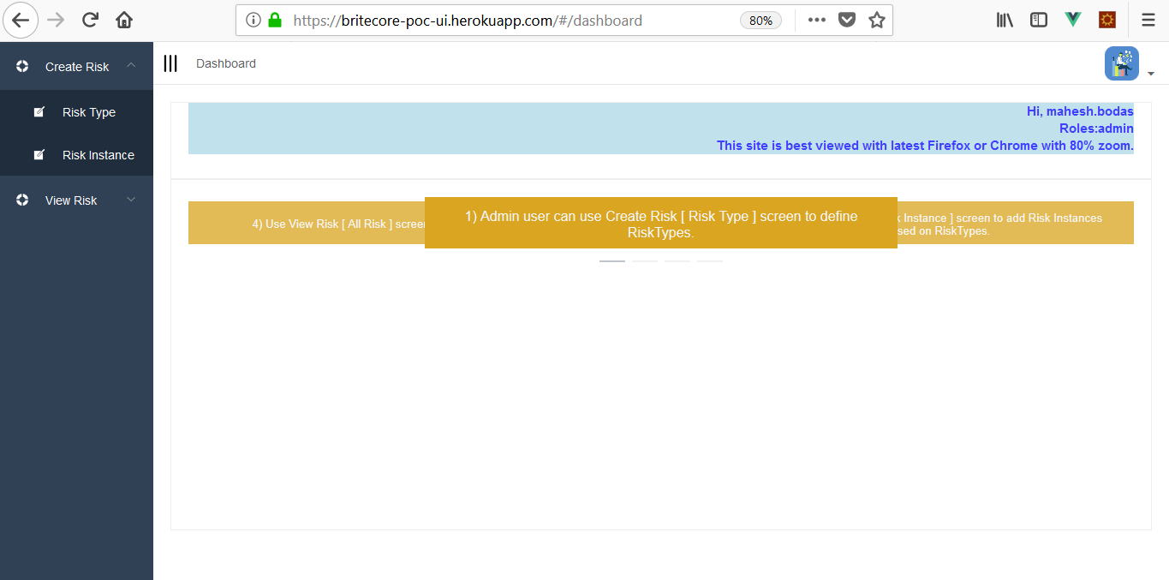
Home Screen

Slide 2
BriteCore PoC UI
https://d68s5r8jupuq9.cloudfront.net
Use above link to access UI.
Username :- phil.reynolds (lower case)
Password :- poctest#1 (lower case)
Best viewed with Firefox with 80 % zoom
Above UI refers Web API at following location credentials are same.
https://2pprl7yzie.execute-api.ap-southeast-1.amazonaws.com/dev

Slide 3
Source code
https://github.com/MaheshBodas/britecore-poc-ui-master

Slide 4
Unit testing
Used VueJS-test-utils along with Jest for doing unit testing.
Did Unit testing for Vuex (Mutation + Action + Getters)
Main Vue components used for showing Single Risk as well as All Risk

Slide 5
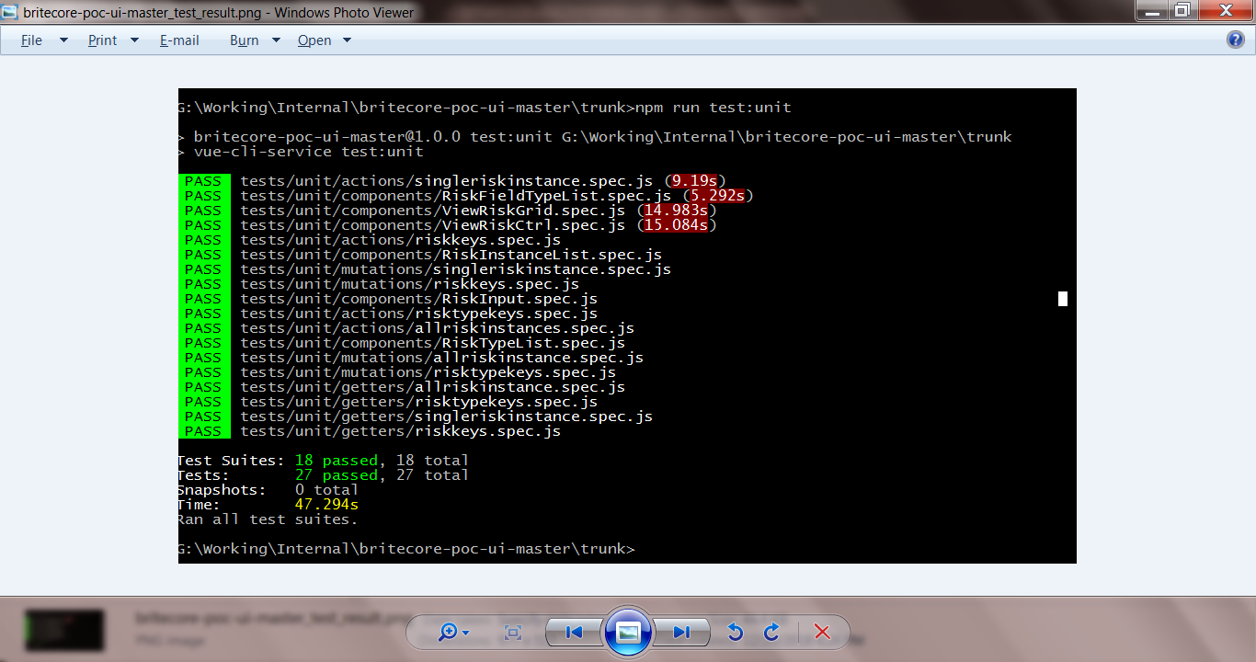

Slide 6
Salient features
Developed using Vue JS, ES6, Element UI library, Node JS, Express server.
Only authenticated users can login and access system. Token based authetication scheme is used.
Role based authorization further limits access to screens and components use for creating RiskTypes.

Slide 7
Salient features (continued)
Well thought Vue components to modularize code.
Each form has help message display that shows how to use screen and detail steps involved.
User can add RiskType and associated RiskTypeFields in one go using header and details table in screen.

Slide 8
Salient features (continued)
User can add Risk and Risk Fields in one go using header and details table in screen.
Create Risk Instance screen collect data by dynamically adding controls related to various Risk type fields.
Create Risk Instance screen dynamically adds required field validation and field type specific validation for controls related to Risk type fields. i.e. Date / float / integer.

Slide 9
Salient features (continued)
View Single Risk allows user to fetch details for given Risk and renders various read-only controls related to Risk Type fields.
Used Vuex store mutations and action methods. Appropriate use of Getters for sharing Vuex store with components.
Used Vue router for login and navigation within various forms within WebSite.

Slide 10
Salient features (continued)
Successful model creation messages are displayed using MessageBox.
Display various model validation errors using MessageBox

Slide 11
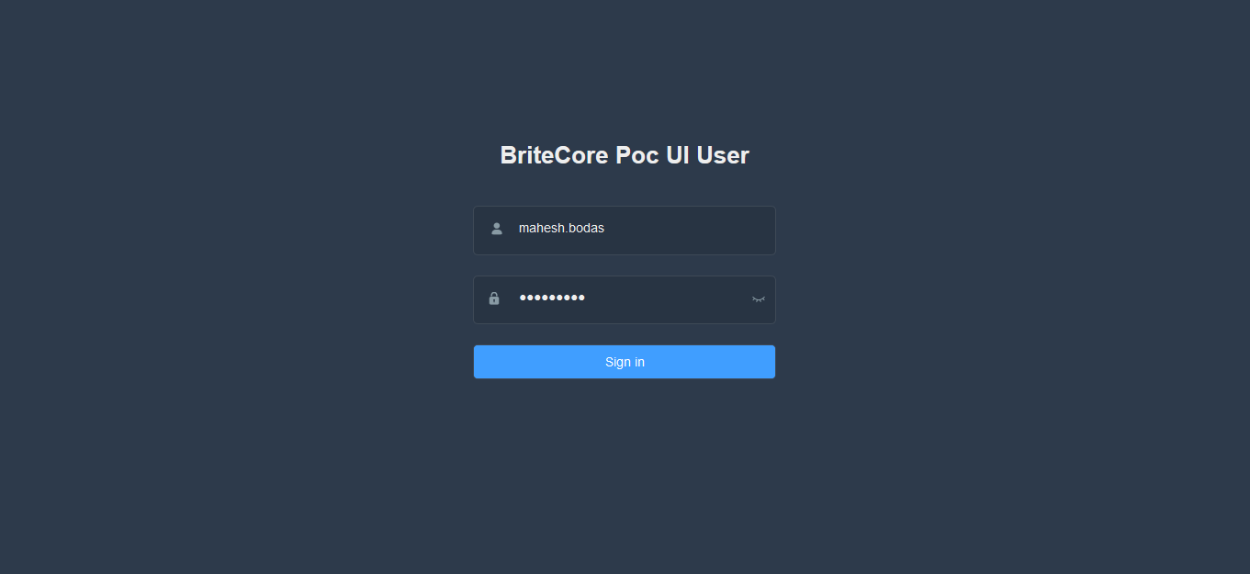
Login Screen

Slide 12
Create Risk Type screen
Admin User can define Risk types.
User Enters Risk type name and description.
Click Add Risk Type Field button to define Risk type fields.
Post Risk type after adding / editing Risk type fields.

Slide 13
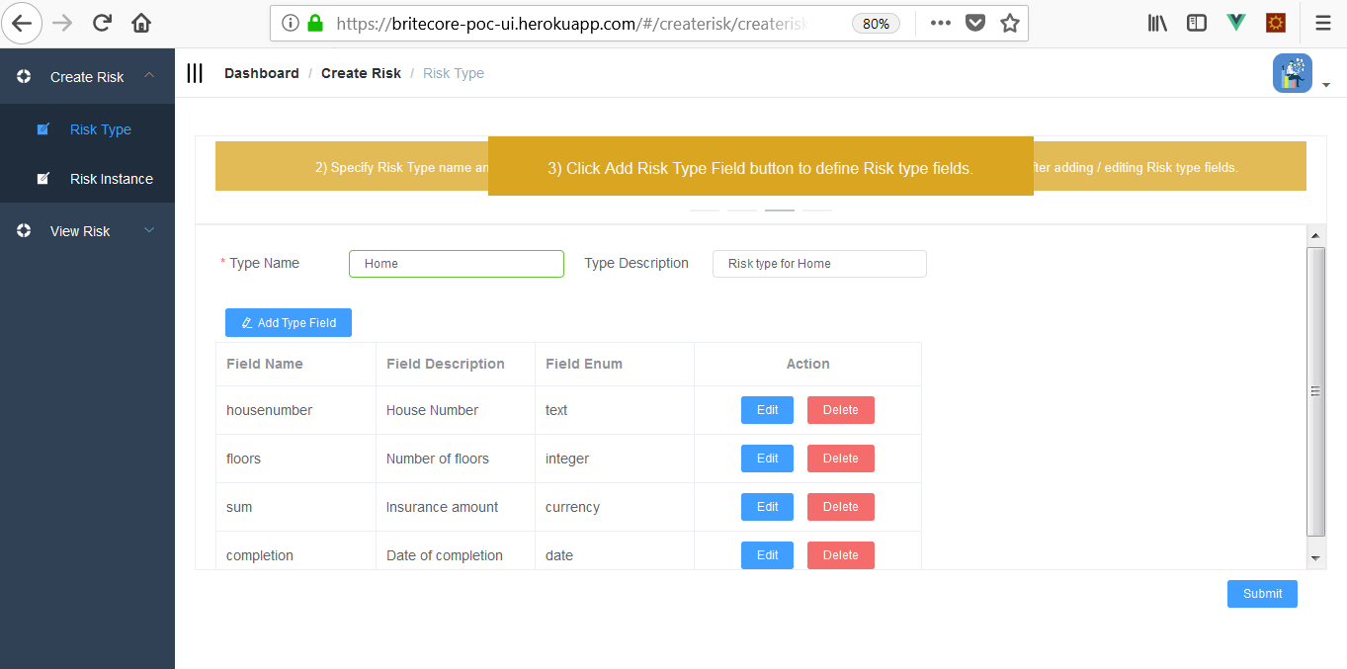
Create Risk Type Image

Slide 14
Risk Type Data posted to server

Slide 15
Create Risk Instance screen.
User can create Risk Instance based on Risk types.
Select appropriate Risk Type from dropdown box.
Fill up all Risk Instance fields and submit form.
Admin user can define Risk Types.

Slide 16
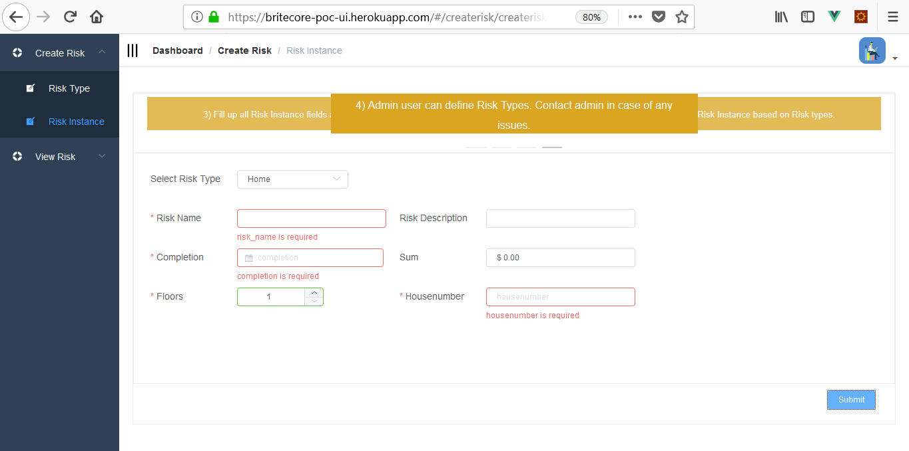
Screen showing field validation errors

Slide 17
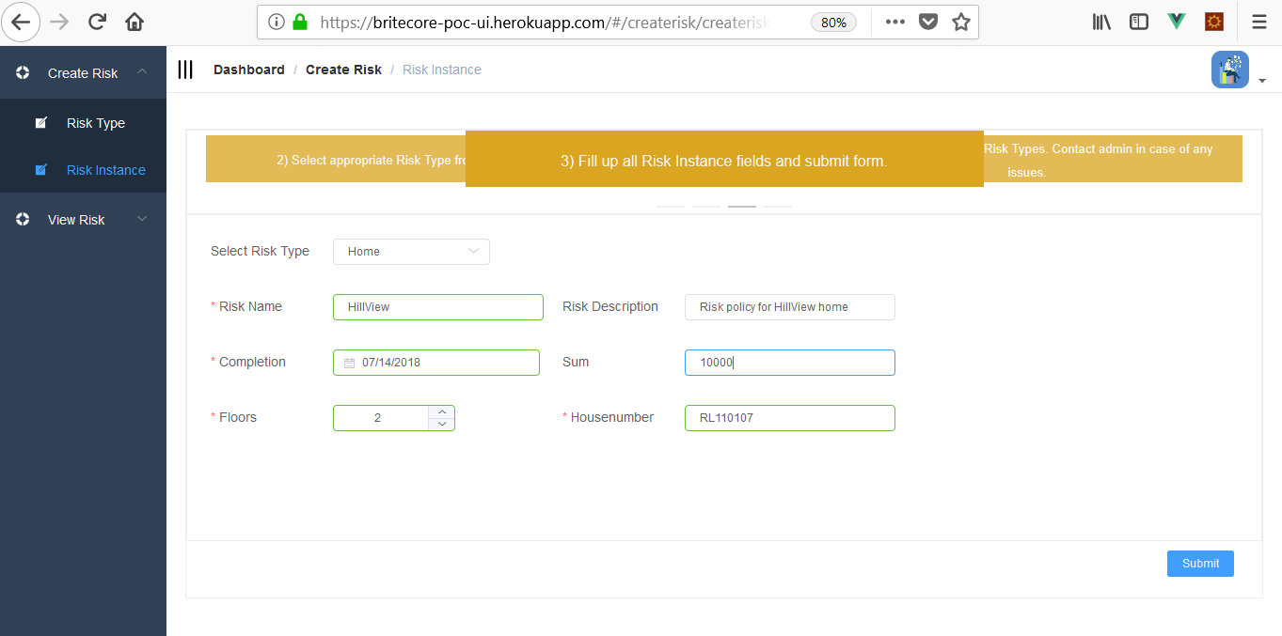
Submit when validation succeed

Slide 18
Posting Risk Instance data to server

Slide 19
View Single Risk Instance
User can view single Risk Instance using this form.
Select appropriate Risk Instance from dropdown box.
Screen will show Risk name and all Risk Instance fields (read-only).

Slide 20
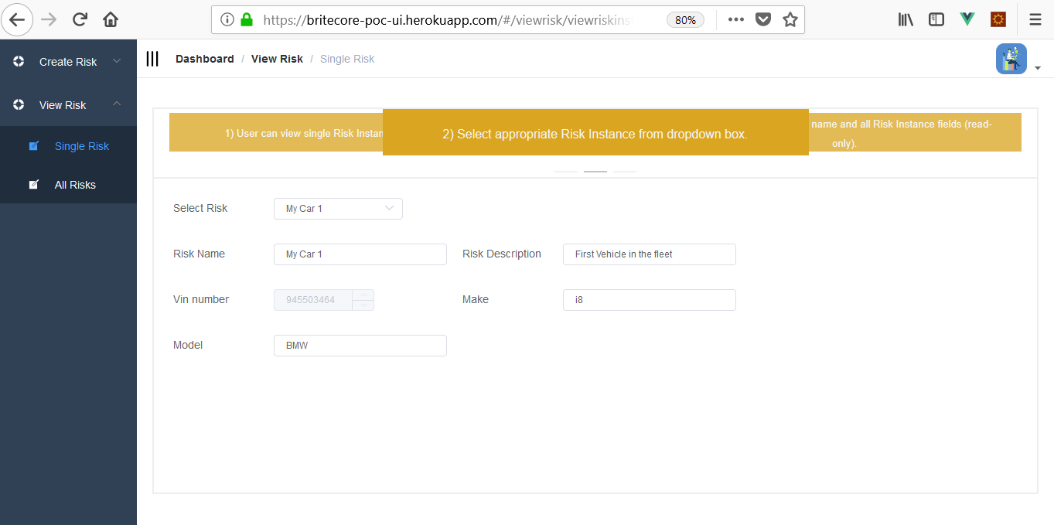
View Single Risk Screen

Slide 21
View All Risks
User can view Risk Instances using this form
Select appropriate Risk Type from dropdown box.
Screen will show all Risks and associated instance fields in tabular format.

Slide 22
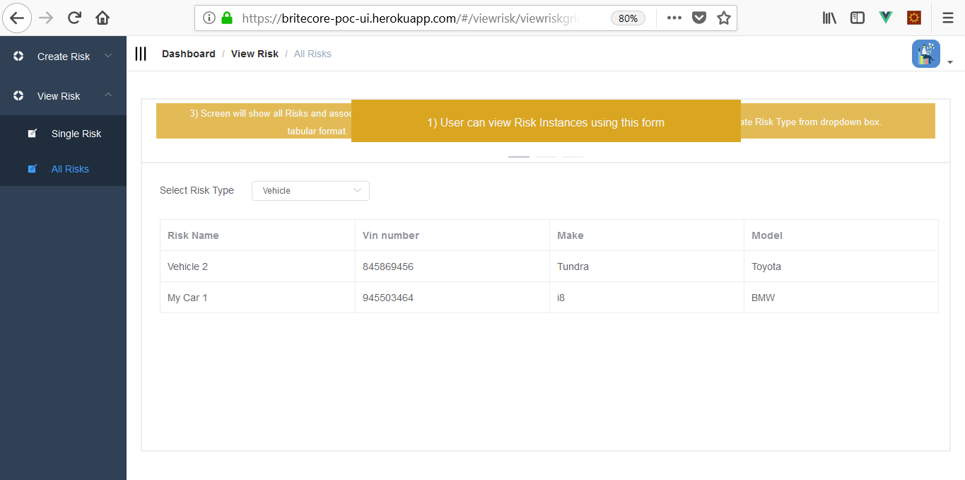
View All Risk Screen

